Slide 1
Day 1 Agenda
DAY
1
Introduction to Formality
1
2
Getting Started with Formality
3
Basic Formality Flow
4b
Reading Designs: Sim/Synth Warnings
5
Matching
6
Verification
Formality 2005.09

Slide 2
Unit Objectives
After completing this unit, you should be able to:
List the three categories of causes for simulation/synthesis differences
Name three tools that will warn you of potential simulation/synthesis differences
Override simulation/synthesis mismatch warnings in Formality
Name the DC and Formality variable that controls how out of range array accesses are handled and explain its operation
Name the two DC pragmas that can give simulation/synthesis differences when used inappropriately
Explain when/how these two pragmas can give simulation/synthesis differences
Explain how you would check Formality warnings of simulation/synthesis mismatches
2

Slide 3
RTL Simulation and Synthesis
Some ‘legal’ coding styles in RTL are interpreted differently by simulation and synthesis
These lead to the possibility that the gate level netlist will have different behavior than the RTL.
  RTL is what’s validated to insure your design meets the functional requirements
  Gates are what get turned into product
What is your goal?
  To be sure that final gates match what you simulated
Your goal is not
  To get a “Verification succeeded” at all costs!
3

Slide 4
Why Simulation / Synthesis Differences?
The problem areas are well understood
No reasonable hardware implementation exists
  Correspond to poor coding practices in RTL
    Example: Incomplete sensitivity list
  Good simulation RTL, but designer didn’t “think hardware”
    Example: Comparison to X
Out of range accesses to arrays
  Results are under variable control in Design Compiler
Synthesis pragmas
  User directives to Design Compiler
  Ignored by simulators
4

Slide 5
Why Simulation / Synthesis Differences?
This is an Instructor Guide page!
Switch to "Notes" view.
Notes:
Why Simulation / Synthesis Differences?
Key Message/Points:
Technical Explanation:
Questions:
Slide Transition:
Instructional Comments:
References/Additional Information:
Category 2 is really a special case of a more general issue: DC preferring area/timing results to strict interpretation of RTL. However, rather than alarm customers I have restricted the category title to “out of range”.
Previously, there were a limited number of cases where Design Compiler’s default behavior was to override the strict interpretation of the Verilog or VHDL Language Reference Manuals and to build a structure which hah better timing/area, but whose function did not match RTL simulation results. The good news is that this is really an HDLC issue. Presto is stricter – the out of range access is the only outstanding issue.
There is a temporary issue for division of signed numbers by a power of 2, but only when a customer uses the HDLC VHDL reader in Design Compiler. There will be no issue once the Presto VHDL reader is the default. Since this issue will “go away” once Presto is the default DC VHLD reader we have not included it in the main slides. However, this topic is described in the backup slides at the end of this section. Use these at your discretion.

Slide 6
Warnings throughout Synopsys flow
LEDA – issues warning
Presto – issues warnings
  but will give gates
Formality – always warns
  Model built depends upon category of warning
  No reasonable hardware implementation
    (By default) set_top will Error out
  Out of range accesses to arrays
    (By default) model for RTL matches simulation
  Synthesis pragmas
    (By default) model for RTL matches simulation
5

Slide 7
Warnings throughout Synopsys flow
This is an Instructor Guide page!
Switch to "Notes" view.
Notes:
Warnings throughout Synopsys flow
Key Message/Points:
Technical Explanation:
Questions:
Slide Transition:
Instructional Comments: This is a high level summary for Formality. Stress that students need to read the more detailed descriptions for the handling of out of range access in VHDL and for Synthesis pragmas.
References/Additional Information:

Slide 8
Simulation-Synthesis Recommendations
Use LEDA Formality rule set to check code
  LEDA Coding Rules Manual (Volume II page 49)
Recommendation – Correct the RTL
  Best Practice
Enforce this and we can skip the rest of this unit ☺
6

Slide 9
No hardware implementation - list
Incomplete sensitivity list
Comparison to X or Z
  Explicit
  Comparison to undriven signals
  Use of “===“ in Verilog
Read before write
Assignment in multiple concurrent processes
Function may not return a value
Initial statements
Delay or transport (VHDL) statements
7

Slide 10
No hardware implementation – list #1
This is an Instructor Guide page!
Switch to "Notes" view.
Notes:
No hardware implementation - list
Slide Transition: This list summarises the warnings that you will meet most frequently. We won’t go through all of them in detail. Instead we’ll go through the first one (incomplete sensitivity list) to understand why simulation/synthesis can differ for an incomplete sensitivity list. For the other warnings, read the manpage and think about how you would try to match simulation behavior in physical gates.
Instructional Comments: all these scenarios can occur in both VHDL and Verilog. In some cases, however (e.g. “function may not return a value”) it is a lot more difficult to write bad VHDL than it is is to write bad Verilog!
References/Additional Information:
The following detailed notes are to assist you if any student reads the manpage for hdlin_warn_on_mismatch_messages and demands an explanation for all the messages! Otherwise there is no need to expose students to this level of detail. In particular the whole RTLC/HDLC issue is best avoided.
The slide is an almost complete list for RTLC. RTLC may also issue the following messages:
(Two VHDL Specific) warnings
FMR_ELAB-125 Non constant signal declared in package
FMR_ELAB-130 Size mismatch in VHDL assignment
Some variants on “out of range”
FMR_ELAB-149 Target integer range is subset of assigned range
FMR_ELAB-154 Target integer range disjoint from assigned range
And two specific warnings that can be issued by RTLC, but both R&D and Applications experience shows are are unlikely to occur. If they do occur see the man pages.
FMR_ELAB-150 Net drives inout port as well as another receiver
FMR_ELAB-153 Possible overflow from multiplication
The manpage for hdlin_warn_on_mismatch_message lists all the simulation/synthesis mismatch messages that RTLC can issue plus messages from HDLC. See next Instructor Guide for more details.

Slide 11
No hardware implementation – list #2
This is an Instructor Guide page!
Switch to "Notes" view.
Notes:
No hardware implementation – list 2
Key Message/Points:
Technical Explanation:
Questions:
Slide Transition:
Instructional Comments:
References/Additional Information:
The following simulation/synthesis mismatch messages can only be issued when HDLC is enabled. They will be removed from the manpage hdlin_warn_on_mismatch_message (and from the code) once HDLC is completely retired. Many of these have RTLC equivalents. The remainder handle situations that will no longer give simulation/synthesis mismatches.
VE-121 Event in verilog assignment (q = @ (posedge ck) d ;
HDL-93 Bit arrays of different widths
HDL-170 Comparisons to Z or X
HDL-176 Non constant value on asynchronous reset
HDL-177 Read before write (local variable)
HDL-179 Variable not in sensitivity list
HDL-180 Another variable not in sensitivity list
HDL-220 Variable driven by more than one process or block
HDL-320 Assignment of 3 state value may cause problem
HDL-370 Full case used, but not all cases are covered
HDL-371 Parallel case with overlapping items
VHDL-2022 Initial values for signals not supported for synthesis
HLS-50 Reset declaration of user and HDL clash.
HLS-91 Inconsistent pipelined loop
HLS-288 Internal error to do with BC!!
DDX-5 Inout port driven statically - treated as an output

Slide 12
Incomplete Sensitivity List - RTL
module top (a, b, q);
input a, b;
output q;
reg q;
always @ (a)
q = a & b;
endmodule
8

Slide 13
Incomplete Sensitivity List - RTL
This is an Instructor Guide page!
Switch to "Notes" view.
Notes:
Incomplete Sensitivity List - RTL
Key Message/Points:
Technical Explanation:
Questions:
Slide Transition:
As an example we’ll take a look at an incomplete sensitivity list to understand:
How simulation will handle the RTL
Why there is no reasonable hardware implementation
The gates that DC will build
How RTL and DC gates will differ in simulation
You will then be able to appreciate that Formality’s default behaviour (to error out) protects you from gates that will have different functionality from the RTL.
Instructional Comments:
References/Additional Information:

Slide 14
Incomplete Sensitivity List – Formality (Overridden)
Set hdlin_warn_on_mismatch_message
Formality model then matches synthesis
  Since no reasonable model we can’t match simulation
Is this what you really want?
9

Slide 15
Incomplete Sensitivity List – Formality (Overridden)
This is an Instructor Guide page!
Switch to "Notes" view.
Notes:
Incomplete Sensitivity List – Formality (Overridden)
Key Message/Points:
Technical Explanation:
Questions:
Slide Transition:
Instructional Comments:
References/Additional Information:
There is another variable hdlin_error_on_mismatch_message. This overrides ALL warnings and we strongly discourage its use. So no mention on slides.

Slide 16
No hardware implementation - checking
Always safest to fix in RTL
  Incomplete sensitivity list
  Comparison to X or Z
Can ignore if system will always be reset before simulation or operation
  Read before write
  Initial statements
Timing dependent
  Delay or transport (VHDL) statements
    OK if total delay on path less than clock period in RTL and in gates
    Example unit delay blocking assignment style is OK
Depends if difference is reachable
  Assignment in multiple concurrent processes
  Function may not return a value
10

Slide 17
No hardware implementation - Summary
Warnings mean real risk that gates will behave differently to simulation
You can override warnings with hdlin_warn_on_mismatch_message
If you override warnings then Formality model will match synthesis not simulation!
Be very careful!
11

Slide 18
Out of range access - Verilog
Consider an 8 bit array with 4 bit address line
What happens with address = 15?
Verilog Language Reference Manual (and VCS)
  Write operation leaves register undisturbed
  Read operation returns 1’bX
12

Slide 19
Out of range access Verilog – DC (default)
For hdlin_dyn_array_bnd_check = false (default)
Input pin address[3] is not read
Access to address 15
  Write operation writes to array[7]
  Read operation returns contents of array[7]
13

Slide 20
Out of range access Verilog – DC (Non default)
For hdlin_dyn_array_bnd_check = true
Input pin address[3] is read
Access to address 15
  Write operation leaves array undisturbed
  Read operation returns ??
  Matches simulation
    In simulation read returns X
14

Slide 21
Out of range access – Formality (Verilog)
Controlled by hdlin_dyn_array_bnd_check
  Important settings are:
    Verilog (default)
    None
Formality models
  For ‘Verilog’ matches simulation
  For ‘None’ matches default synthesis
15

Slide 22
Out of range access – Formality (Verilog)
This is an Instructor Guide page!
Switch to "Notes" view.
Notes:
Out of range access – Formality (Verilog)
Key Message/Points:
Technical Explanation:
Questions:
Slide Transition:
Instructional Comments:
References/Additional Information:
There are actually 4 settings for the variable Verilog, None, VHDL and Both. Students from Verilog only customers they only need to worry about Verilog and None. Slide X explains VHDL settings.

Slide 23
Out of range access – Formality (VHDL)
Simulation
  Out of range access is a VHDL runtime error
Design Compiler
  As Verilog
Formality
  Controlled by hdlin_dyn_array_bnd_check
    Important settings are Verilog (default) and VHDL
  (By default) Formality matches synthesis for VHDL Files
    Since out of range access is a runtime error your RTL and synthesized gates will not “disagree” in simulation
16

Slide 24
Out of range access – Formality (VHDL)
This is an Instructor Guide page!
Switch to "Notes" view.
Notes:
Out of range access – Formality (VHDL)
Key Message/Points: This really is a Verilog only issue. VHDL is much stricter, so if out of range access occurs in simulation there is a runtime error. Therefore there is not the same risk of RTL and gates simulating (without errors) but differently> Therefore Formality has chose to match synthesis byd efault.
Technical Explanation: This slide is for completeness. Default behavior differs
Questions:
Slide Transition:
Instructional Comments:
References/Additional Information:

Slide 25
Out of range access - Recommendations
For Verilog RTL
  Change the default setting of hdlin_dyn_array_bnd_check in your master DC .synopsys_dc.setup file to true!
  Leave Formality hdlin_dyn_array_bnd_check in default state of Verilog
  Change default setting to None (or VHDL) only if you’re sure!
For VHDL RTL
  Use default settings in both DC and Formality
17

Slide 26
Synthesis Pragmas
Pragmas are comments in RTL code that provide information to Design Compiler
Most commonly used pragmas are:
  synthesis_on / synthesis_off
  translate_on / translate_off
  dc_script_begin / dc_script_end
  parallel_case
  full_case
Simulators ignore pragma information
Risk:
  DC uses the pragma information to create a netlist that simulates differently from the RTL
18

Slide 27
How Does Formality Handle Pragmas?
(Default) Formality ignores
  dc_script_begin / dc_script_end
  parallel_case
  full_case
(Default) Formality respects
  synthesis on / synthesis_off
  translate on / translate_off
  Design intent in these cases is clear.
Tcl variables control Formality behavior
  hdlin_ignore_synthesis
  hdlin_ignore_translate
  hdlin_ignore_dc_script
  hdlin_ignore_parallel_case
  hdlin_ignore_full_case
19

Slide 28
How Does Formality Handle Pragmas?
This is an Instructor Guide page!
Switch to "Notes" view.
Notes:
How Does Formality Handle Pragmas?
Key Message/Points: Formality’s defaults are a safe interpretation that ensures all possible mismatches are caught.
References/Additional Information:
Setting hdlin_ignore_dc_script false will typically just get you a lot of warnings that Formality does not support the dc script commands.
An alert student might try "printvar hdlin_ignore_*" and ask, why aren't you telling us about the rest of the variables? Here is a full answer - edit down as appropriate: The remaining hdlin_gnore_* variables are:
1) Two VHDL specific variables that are there for historic reasons
hdlin_ignore_builtin
hdlin_ignore_resolution_method)
The DC pragmas builtin and resolution_method are not required in a modern flow involving std_logic_arith or numeric_std packages.
We would advise you just to leave these alone.
2) Five variables all to do with DC pragmas that can be used to control selection and implementation of DWARE components.
hdlin_ignore_label
hdlin_ignore_label_applies_to
hdlin_ignore_map_to_entity
hdlin_ignore_map_to_module
hdlin_ignore_map_to_operator
In practice these are rarely used by customers.
Formality does not support any of these pragmas. Formality models will always be based on the RTL constructs that are actually simulated. There is no value in doing anything else.
By default Formality does not warn you when the associated pragmas are used in your RTL. If you change the setting of the hdlin_ignore_* variables you will see lots of warning about unsupported constructs.
Be aware that there is an irritating (but insignificant) difference between Formality support for VHDL and Verilog. For VHDL examples based on the DWARE Foundation User Guide will read in quietly without any warnings when these variables are in their default state (true). However, for Verilog, whenever you use these pragmas you will also use the "resource" pragma, and this will generate "unsupported pragma" warnings. No way to turn off warnings for "resource".

Slide 29
Full_case and Parallel_case
// synopsys full_case
  Asserts that all possible clauses of a case statement have been covered
  Avoids the need for default logic, and
  Can avoid latch inference from a case statement by asserting that all necessary conditions are covered by the given branches of the case statement.
// synopsys parallel_case
  Tells the synthesis tool to evaluate all case-items in parallel.
  Generates multiplexer logic instead of priority encode logic.
Both can lead to simulation/synthesis differences if used inappropriately!
20

Slide 30
Possible false equivalence from full_case
Here are the conditions that would have to exist:
  User forces Formality to obey full_case pragma
  Not all cases are covered - error condition by default
  User forces downgrade of error to warning
  The uncovered case is reachable in the full design context (…could use Magellan to find out)
  User ignores RTL interpretation warning message
Always safer to use a default clause.
21

Slide 31
full_case - Example
module block_b (current_state, next_state);
input [3:0] current_state;
output [3:0] next_state;
parameter state1 = 4'b0001, state2 = 4'b0010,
state3 = 4'b0100;
reg [3:0] next_state;
always @ (current_state)
case (1) // synopsys full_case
current_state[0] : next_state = state2;
current_state[1] : next_state = state3;
current_state[2] : next_state = state1;
endcase
endmodule
22

Slide 32
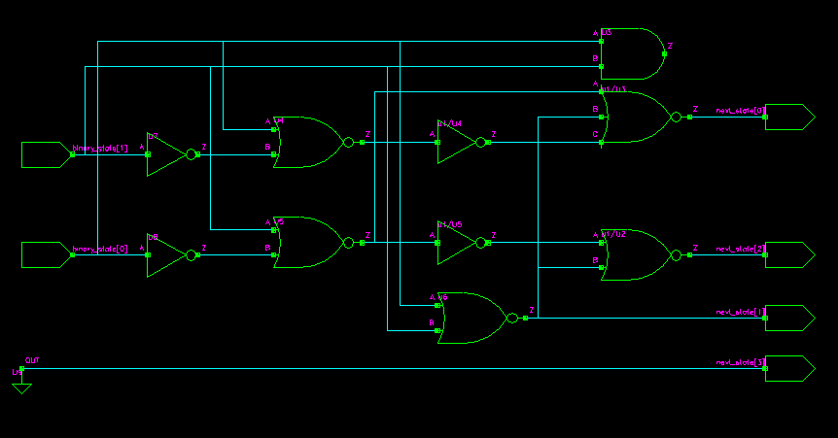
full_case - Example
Gates produced by DC using full_case
23

Slide 33
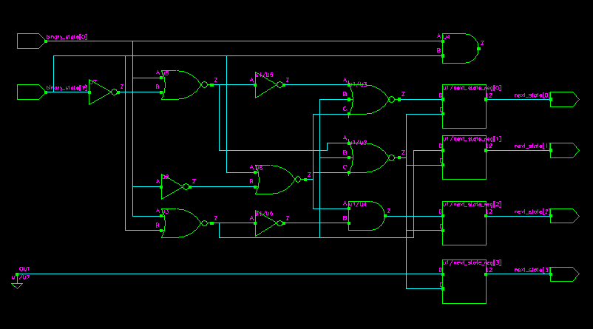
full_case - Example
Gates produced by DC without using full_case
24

Slide 34
full_case – Simulation Results
Simulation of Verilog code
Simulation of gates from DC
Chronologic VCS simulator copyright 1991-1997
Contains Viewlogic proprietary information.
Compiler version 4.0.3; Runtime version 4.0.3; Feb 3 19:11 2000
Simulation of top.v
-------------------
in=00 out=0010
in=01 out=0100
in=10 out=0001
in=11 out=0001
in=00 out=0010
in=11 out=0010
in=01 out=0100
in=11 out=0100
$stop at time 8000 Scope: testbench File: top.testbench.v Line: 24
C1 >
Chronologic VCS simulator copyright 1991-1997
Contains Viewlogic proprietary information.
Compiler version 4.0.3; Runtime version 4.0.3; Feb 3 16:59 2000
Simulation of top.v
-------------------
in=00 out=0010
in=01 out=0100
in=10 out=0001
in=11 out=0001
in=00 out=0010
in=11 out=0001
in=01 out=0100
in=11 out=0001
$stop at time 8000 Scope: testbench File: top.testbench.v Line: 24
C1 >
25

Slide 35
full_case - Simulation Results: explanation
When simulating the RTL code
  If the input to the case statement is not one of the listed case items
    The output of the case statement holds its value from the previous state
When simulating the gate level netlist
  If the input to the case statement is not one of the listed case items
    The output of the case statement is the output of the combinational logic that the synthesis tool optimized for the other case items
26

Slide 36
fulll_case - Summary
Improper use of the full_case pragma can result in a netlist that simulates differently than your RTL
When you apply an external constraint to your synthesis tool (in the form of a RTL pragma) you need to be sure that the constraint is valid
27

Slide 37
Is Difference Reachable?
Formality is a static equivalence checker
  For all 3 categories difference may not be reachable
Example
  Full case for one hot decoding driven by one hot counter
  In simulation/operation no problem – provided there is a power on reset
Formality considers all 2**n states
How to handle?
  Check with Formal Vera
  Apply constraint
  Override warning
28

Slide 38
Simulation / Synthesis Summary
Check and understand the warnings!
Scenarios that can lead to failing verification
  Abuse of full_case / parallel_case
  Different default settings of hdlin_dyn_bnd_array_check
  Others ….
Scenarios that can lead to silicon / simulation mismatch
  Overriding default settings without checking
29

Slide 39
Review Questions
List the three categories of causes for simulation/synthesis differences
Name three tools that will warn you of potential simulation/synthesis differences
Explain how you would override simulation/synthesis mismatch warnings in Formality
Name the DC and Formality variable that controls how out of range array accesses are handled and explain its operation
Name the two DC pragmas that can give simulation/synthesis differences when used inappropriately
Explain when/how these two pragmas can give simulation/synthesis differences
Explain how you would check Formality warnings of simulation/synthesis mismatches

Slide 40
Lab 4: Design Read
Lab 4 :
  ???
25

Slide 41
Backup Slides
30

Slide 42
VHDL Signed Division by Power of 2
For DC HDLC Reader
  DC implements division by power of 2 as shift
  Results differ from simulation for negative numerator
Formality VHDL Reader gives sim/synth warning
  FMR_ELAB-151
  If you override warning Formality model matches DC and not simulation (default)
Formality can match simulation in VHDL
  Set hdlin_vhdl_presto_shift_div true
31

Slide 43
Presto VHDL: Signed Division by Power of 2
For DC Presto Reader
  DC (by default) matches simulation results
  Can enable old behavior by setting
    hdlin_signed_division_use_shift true
Recommendation when using VHDL Presto (Current)
  Set DC and Formality to match simulation
    # Use default value in DC
    set hdlin_signed_division_use_shift false
    # Formality, enable simulation model
    set hdlin_vhdl_presto_shift_div true
In future releases, when Presto is default DC VHDL reader
  Formality defaults will match simulation
  Therefore, leave DC and Formality in default settings
32

